Slide 1
Interfacing Stepper motor to 8051 microcontroller
A motor is one which translates electrical pulses into
mechanical motion.
Types of motor are:
Stepper Motor
DC Motor
AC Motor
A stepper motor is a special type of electric motor that moves in increments, or steps, rather than turning smoothly as a conventional motor does.
Typical increments are 0.9 or 1.8 degrees, with 400 or 200 increments thus representing a full circle.
The speed of the motor is determined by the time delay between each incremental movement.
Two types of stepper motor are:
  Permanent Magnet (PM) 2. Variable Reluctance (VR)

Slide 2
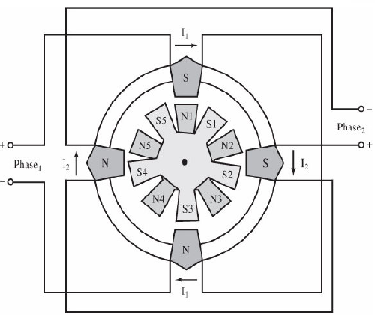

Motor Moves Each Time a Pulse is Received
Can Control Movement (Direction and Amount) Easily
Can Force Motor to Hold Position Against an Opposing Force

Slide 3
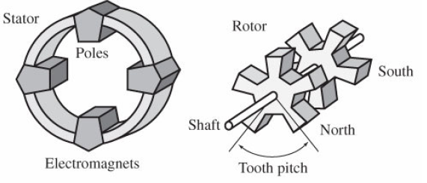

Construction
Permanent Magnet Rotor
  Also Called the Shaft
Stator
  Surrounds the Shaft
  Usually Four Stator Windings Paired with Center-Tapped Common
    Known as Four-Phase or Unipolar Stepper Motor

Slide 4
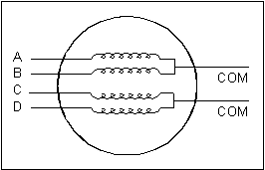
Construction (con’t)
Center Tapped Common

Slide 5
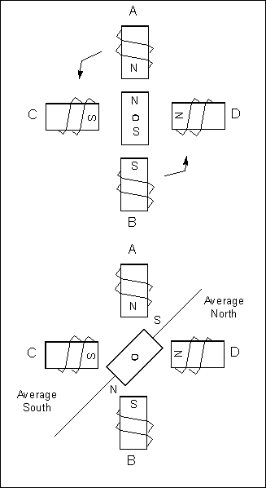
Moving the Rotor
Unstable
Stable
Rotor will ALWAYS seek a stable position.

Slide 6
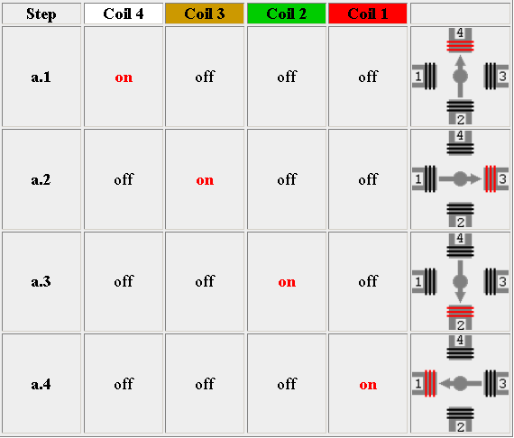
Single-Coil Excitation - Each successive coil is energised in turn.

Slide 7
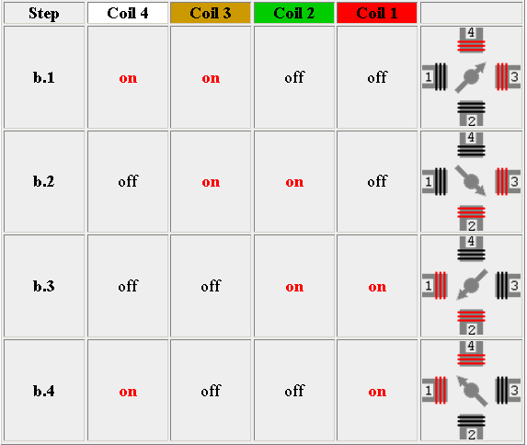
Two-Coil Excitation - Each successive pair of adjacent coils is energised in turn.

Slide 8
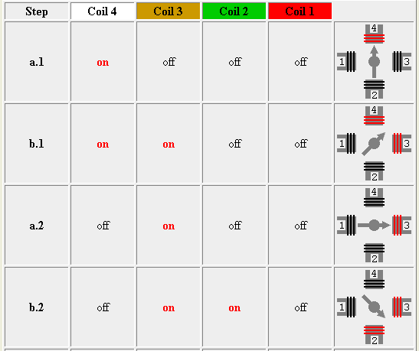
Interleaving the two sequences will cause the motor to half-step
8 step sequence = normal 4 step + wave drive 4 step.

Slide 9
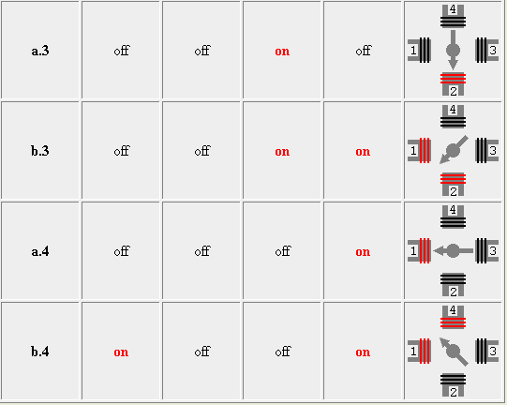

Slide 10


Single-Coil Excitation
Two-Coil Excitation
Interleaved Single- and Two-Coil Excitation
Half-Stepping

Slide 11
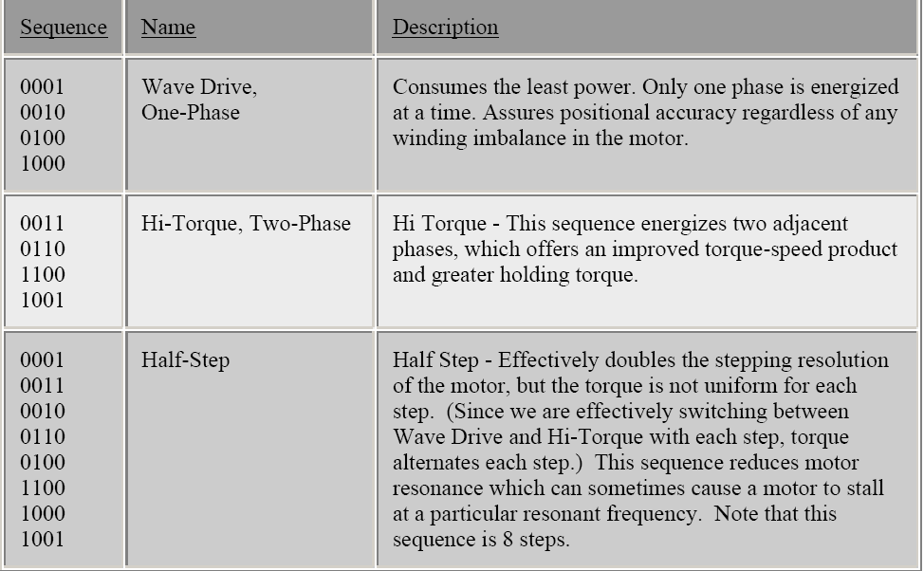

Slide 12
How Far Does It Move?
Step Angle
  Arc Through Which Motor Turns With ONE Step Change of the Windings
  Varies With Model of Stepper Motor
  (Depending on the number of teeth on stator and rotor)
  Normally in Degrees
  Step angle = 360/No. of Steps per Revolution
  Commonly available no. of steps per revolution are 500, 200, 180, 144, 72, 48, 24

Slide 13
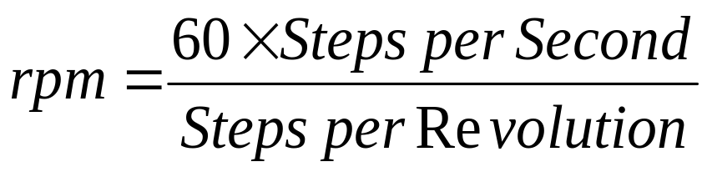
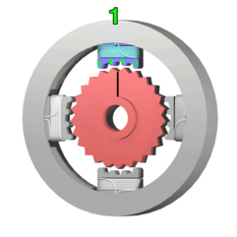
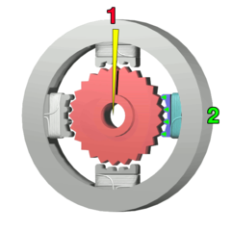
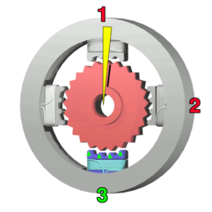
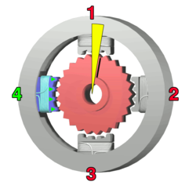
How Fast?
Revolutions per Minute (RPM)
The top electromagnet (1) is turned
on, attracting the nearest teeth of a
gear-shaped iron rotor. With the
teeth aligned to electromagnet 1,
they will be slightly offset from
electromagnet 2.
The top electromagnet (1)
is turned off, and the right
electromagnet (2) is
energized, pulling the
nearest teeth slightly to
the right. This results
in a rotation of 3.6° (1.8’)
in this example.
The bottom
Electromagnet (3)
is energized;
another 3.6° (1.8’)
rotation occurs.
The left electromagnet (4) is enabled,
rotating again by 3.6° (1.8’).
When the top electromagnet (1)
is again enabled, the teeth in the
sprocket will have rotated by
one tooth position; since there
are 25(50) teeth, it will take 100(200)
steps to make a full rotation in this example.

Slide 14
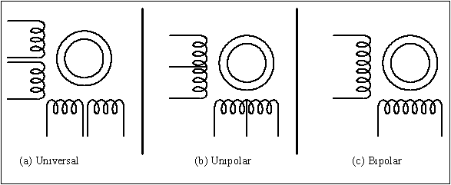
Common Stepper Motor Types

Slide 15
Drivers
May Need a Driver Circuit
  Same Problem as Relays – May Draw Too Much Current
Types
  Transistor Drivers
    Usually a Darlington Pair
  Darlington Arrays
  Can Build It Yourself

Slide 16
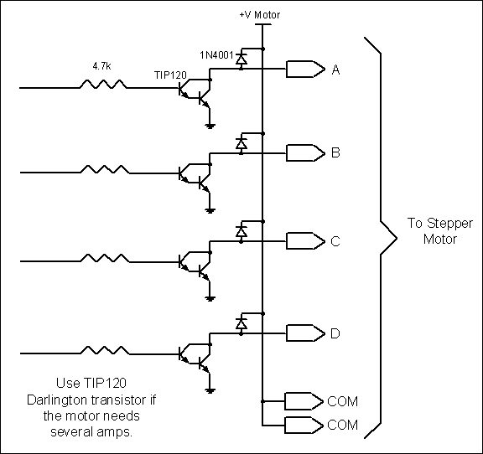
Using Transistors for Stepper Motor Driver

Slide 17
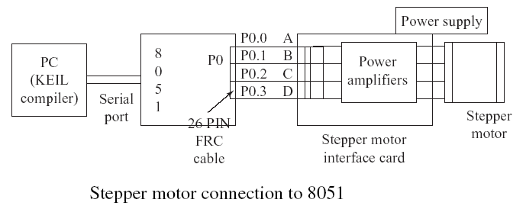
Applications:
Used in
In instrumentation such as watches, clocks, etc.
Computer peripherals such as card readers, teleprinters, teletypes,
dot matrix printers, etc.
Robotics

Slide 18
//Program for stepper motor interface
#include <REG51xD2.H>
void delay (unsigned int x) /* Delay Routine */
{
for(;x>0;x--);
return;
}
void main ( )
{
unsigned char Val, i;
P0=0x00;
Val = 0x11;
for (i=0;i<4;i++)
{
P0 = Val;
Val = Val<<1; /* Val= Val>>1; for clockwise direction*/
delay (500);
}}

Slide 19
Interfacing DC motor to 8051 microcontroller

Slide 20
DC Motors
Only One Winding
Two Connections: + and –
Reversing Polarity Reverses Motor
Move Continuously
Cannot Determine Position

Slide 21
Characteristics:
RPM
  No Load: Maximum RPM With No Load on Shaft
    Given in Data Sheets
  Loaded: Actual Maximum When Loaded
    Not in Most Data Sheets
Voltage Range
  Speed Increases With Voltage on a Given Motor
Current Draw
  Data Sheet Rating Is With Nominal Voltage and No Load
  Increases With Load
Speed Decreases With Load

Slide 22
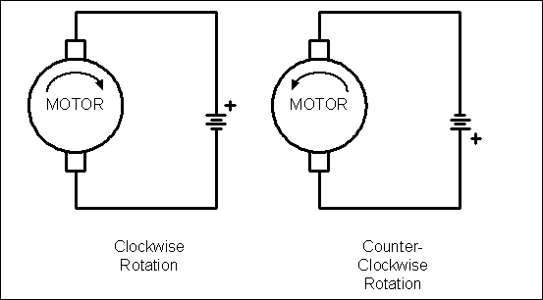
DC Motor Rotation (Permanent Magnet Field)

Slide 23
Bi-Directional Control
Can Change Polarity With a Little Work
H-Bridge Is Simplest Method
  Uses Switches (Relays Will do)

Slide 24
Controlling Speed
Speed Depends On
  Load
  Voltage
  Current
Can Control Power By Changing (Modulating) Width of Pulse to Motor
  Wider Pulse ➔ Faster Speed
  Narrower Pulse ➔ Slower Speed
Note: Doesn’t Work With AC Motors
  AC Motor Speed Depends on AC Frequency (CPS)

Slide 25
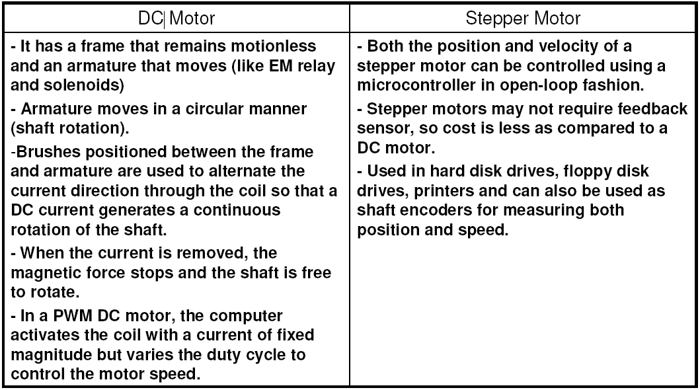

Slide 26
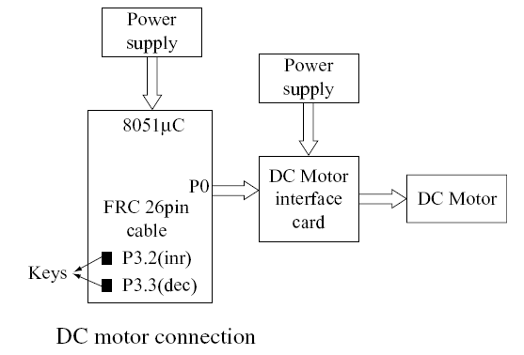

Slide 27
#include<REG51xD2.H>
sbit inr=P3ˆ2; //speed increment switch
sbit dcr=P3ˆ3; //speed decrement switch
main()
{unsigned char i=0×80; //i has initial speed value=half speed = 80 H
P3=0×ff; //configure P3 to accept switches
while(1)
{if (!inr) //if increment is pressed
{while (!inr); //wait till key is released
if (i>10) //if speed is more than minimum
i=i-10; //increase the DC motor speed, by decreasing the count
} //end of if
if (!dcr) //if decrement is pressed
{while (!dcr); //wait till key is released
if (i<0xf0) //decrease the DC motor speed, by increasing the count
} //end of if
P0=i; //output the value to port P0 for speed control
} } //end of while and main

Slide 28
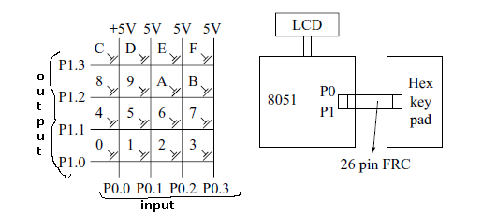
Hex keypad
Placement of keys on port lines Connection of Hex keypad to 8051

Slide 29
#include<reg51xd2.h>
#include<intrins.h>
#include"lcd.h"
unsigned char rows,columns,result;
unsigned char temp = 0;
void delay() //delay subroutine
{unsigned int i;
for(i=0;i<=20000;i++);}
//display subroutine to convert hex to ASCII and display on LCD
void Display()
{if(result>0x09)
{result += 0x37; //if value is greater than 9, add 37H
WriteChar(result);}
else
{result += 0x30; //if value is between 0 to 9, add 30H
WriteChar(result);}
} //end of display subroutine

Slide 30
void KeyScan() //Keypad subroutine
{again:columns = 0x0e; //make P1.0 low
rows = 0x04; //4 rows to check
result = 0x0; //Key value starts at ‘0’
next: P1 = columns; //output columns
CY = 1; //make CY = 1 for next rotation
columns <<= 1; //rotate ‘columns’ left
temp = P0; //store in temp
temp = (temp & 0x0f);
if(temp != 0x0f); //if key pressed
{rot: temp>> = 1;
if(!CY)
{ClrLcd(); //key found
return;}
else
{result += 1; //next column; key value is incremented
goto rot;}
}

Slide 31
else
{result += 0x04; //for next row; 4 is added to key value
rows - -; //decrement number of rows
if(rows = = 0)
goto again; //start from beginning
else
{goto next; }
}}
void main()
{P0 = 0xff; //make as input port
P1 = 0x00;
InitLcd(); //initialize LCD
WriteString("KEY PRESSED=")
while(1)
{KeyScan(); //call keypad subroutine
WriteString("KEY PRESSED=")
Display(); //display the value
} }

Slide 32
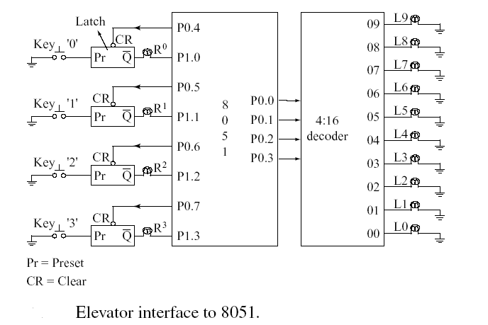
ELEVATOR INTERFACE TO 8051

Slide 33
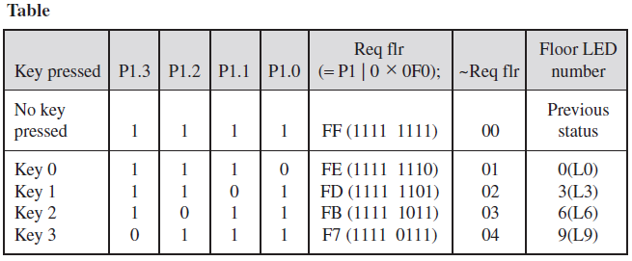

Slide 34
#include<reg51xd2.H>
void delay(unsigned int);
main()
{unsigned char Flr[9] = {0xff,0x00,0x03,0xff,0x06,0xff,0xff,0xff,0x09};
unsigned char ReqFlr,CurFlr = 0x01,i,j;
P0 = 0x00;
P0 = 0xf0;
while(1)
{P1 = 0x0f;
ReqFlr = P1|0xf0;
while(ReqFlr == 0xff)
ReqFlr = P1|0xf0; //Read Request Floor from P1
ReqFlr = ~ ReqFlr;
if(CurFlr == ReqFlr) //If request floor is equal to current floor
{P0 = Flr[CurFlr]; //Clear Floor Indicator
P0 = P0|0xf0; //Enable again
continue; //Go up to read again
}

Slide 35
else if (CurFlr > ReqFlr) //If current floor is > request floor
{
i = Flr[CurFlr] - Flr[ReqFlr]; //Get the no of floors to travel
j = Flr[CurFlr];
for(; i>0; i- -) //Move the indicator down
{P0 = 0x0f0 | j;
j- -;
delay(25000);
}}
else //If Current floor is < request floor
{i = Flr[ReqFlr] - Flr[CurFlr]; //Get the no of floors to travel
j = Flr[CurFlr];
for(; i>0; i- -) //Move the indicator Up
{P0=0×f0 | j;
j++;
delay(25000);
}}

Slide 36
CurFlr = ReqFlr; //Update current floor
P0 = Flr[CurFlr]; //Clear the request indicator
P0 = P0|0xf0;
} //end of while
} //end of main
void delay(unsigned int x)
{for(; x>0; x- -);}

Slide 37
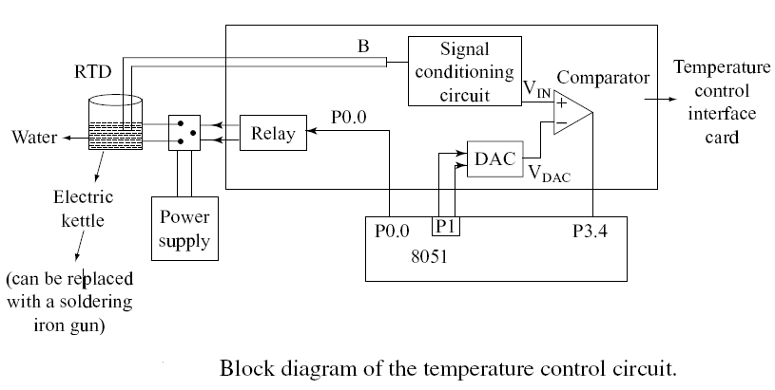
Temperature Transducer

Slide 38
The following are the Port connections for 89C51ED2 and
ICL7109(ADC)
i/p :P0 is connected to data lines of the ADC
o/p :P2 lower nible ADC control lines
o/p P1.1 ---- relay control .
o/p :P2.0 --- LBEN active low
o/p :P2.1 --- HBEN active low
o/p :P2.2 --- CE active low
o/p :P2.3 --- RUN active high
o/p :P2.4 --- RELAY active high
i/p :P1.0 --- Status of ADC:- ready when low

Slide 39
An electrical transducer is a sensing device using which a physical, mechanical or optical quantity to be measured is transformed into electrical signal (voltage or current) proportional to input.
PT100 is a temperature transducer which converts change in temperature to change in resistance.
Change in resistance is represented by change in voltage using a resistance bridge.
A RTD (Resistance Temperature Detector) is a temperature sensing device whose resistance increases with temperature. Resistance of RTD is calculated by Wheat stone bridge.
Vo = VEX( R3/[R3+R4]) – VEX(R2/[R1+R2])
R4 = ((R1(VEX-Vo) - R2 Vo)R3) / (R1 Vo + R2 (VEX + Vo))
If R1=R2=R3=100Ω and bridge ix excited at VEX = 1.8V
Then, R4= ((100(1.8-Vo) – 100*Vo)100) / (100*Vo + 100(1.8+Vo))
Analog output of resistance bridge is converted to digital output which is read by 8051 microcntroller, which in-turn controls the power to the heating element. It uses 12-bit dual slope integrating ADC (ICL 7109).

Slide 40
# include <reg51xd2.h>
#include "lcd.h"
unsigned int Adc;
unsigned char Low_adc,High_adc,relay;
sbit ce=P2^2, rc=P1^1, LBEN=P2^0, HBEN=P2^1, soc=P2^3;
read_adc()
{unsigned char status;
soc = 1 ; // Start conversion of ADC
status = P1; //Read status of ADC
while((status & 0x01) != 0x01)
{status = P1;}
ce = 0; // Enable outputs
LBEN = 0; // Activate B1 to B8 outputs
Low_adc = P0; // Read lower byte of ADC and place in R0
LBEN = 1; // Deactivate B1 to B8 outputs
HBEN = 0; // Activate B9 to B12 and POL, over range outputs
High_adc = P0; // Read higher byte of ADC
High_adc = High_adc & 0x0F;

Slide 41
HBEN= 1; // deactivate B9 to B12 and POL, over range outputs
ce = 1; // Disable outputs
soc = 0; // Stop conversion of ADC}
main()
{ float Temp,Vol,Res;
unsigned char Temp1,Temp2,Temp3;
P0 = 0xFF ; // Make port 0 as input
P2 = 0xFF ; // Make port 2 as high now the relay is on.
rc = 0 ; // switch OFF relay
soc = 0 ; // STOP conversion of ADC
while(1)
{read_adc(); //Read ADC
Adc = High_adc;
Adc <<= 8;
Adc = Adc | Low_adc;
if( (Adc > 0x656) && (relay != 0)) //IF > 0x0656 Switch OFF relay
{ClrLcd();
WriteString("RELAY OFF");

Slide 42
rc = 0 ;
relay = 0;}
else if ( (Adc < 0x656) && (relay!= 1))
//IF less than 0x05B9Switch ON relay
{
ClrLcd();
WriteString("RELAY ON");
rc = 1 ;
relay = 1;
}
Vol = -((Adc/10)*0.000488); //voltage before amplifier
Res =((100*(1.8-Vol)-100*Vol)*100) /(100*Vol +100*(1.8+Vol)); // Resistance Value
Res = Res - 100;
Temp = Res/ 0.384;
Temp1 = Temp;
Temp2 = 0x30 + (Temp1 / 0x0A);
Temp3 = 0x30 + (Temp1 % 0x0A);

Slide 43
GotoXY(0,1);
WriteString("Temperature ");
WriteChar(Temp2);
WriteChar(Temp3);
WriteString("'C");
}
}

Slide 44
